Slide 1
Reproducing FaceXFormer
A Unified Transformer for Multi-Task Facial Analysis
ICCV 2025 · Narayan, VS, Chellappa, Patel · Johns Hopkins University
Presented by Preetom Saha Arko & Md Kamruzzaman Kamrul · Purdue University
10 Tasks
8 Tasks
127,735
12 Datasets
claimed in paper
reproduced (our scope)
test samples evaluated
across all tasks
Reproducibility as a first-class scientific contribution — rebuilding the full training pipeline from scratch
Released by original authors: weights + inference code only — no training loop, no dataloaders, no loss implementations, no multi-task sampler

Slide 2
Motivation and Related Works
Existing approach: Different specialized models for different facial analysis tasks
Computationally intensive
Impractical for real-time applications
Even recent multi-task facial analysis models such as SwinFace [1], Faceptor [2] and QFace [3] are
not suited for real-time applications
don’t cover a wide range of tasks
Solution: Single model capable of addressing multiple facial tasks
Learns a robust and generalized face representation capable of handling “in-the-wild” images
Learns task-invariant representation because of intra-task modeling
Reduced computational overhead and faster inference
[1] Qin, Lixiong, et al. "SwinFace: A multi-task transformer for face recognition, expression recognition, age estimation and attribute estimation." IEEE Transactions on Circuits and Systems for Video Technology 34.4 (2023): 2223-2234.
[2] Qin, Lixiong, et al. "Faceptor: A generalist model for face perception." European Conference on Computer Vision. Cham: Springer Nature Switzerland, 2024.
[3] Sun, Haomiao, et al. "Task-adaptive q-face." arXiv preprint arXiv:2405.09059 (2024).

Slide 3
Paper Overview: FaceXFormer
What it is · What it claims · Why reproducing it is hard
What FaceXFormer Does
Architecture Key Claims
Single transformer model · 10 facial analysis tasks
Real-time inference
Real-time inference at 33.21 fps
Bi-directional CA
Lightweight decoder with novel bi-directional cross attention
Face Parsing: pixel level semantic face segmentation
SOTA performance
SOTA or near SOTA performance on multiple facial analysis tasks
Landmark Detection: locate facial structural key points
Head Pose Estimation: predict 3D pitch, yaw, roll
No face pretraining
Relies purely on multi-task co-training with ImageNet pretrained encoder
Attribute Prediction: classify multiple binary facial traits
Why Reproduction Is Non-Trivial
Age Estimation: predict age of subject
No training loop released
Entire training pipeline (including loss functions) implemented from scratch
Gender Estimation: classify subject as male or female
Race Estimation: classify subject into ethnic groups
No dataset loaders
11 datasets downloaded, custom adapters per task
Face Visibility Prediction: determine occlusion state of facial features
Multiple inconsistencies
Four critical inconsistencies between the paper and the Github repository
Facial Expression Recognition: classify subject's current emotional state
The authors released pretrained weights and inference code only.
Face Recognition: identify a person's identity

Slide 4
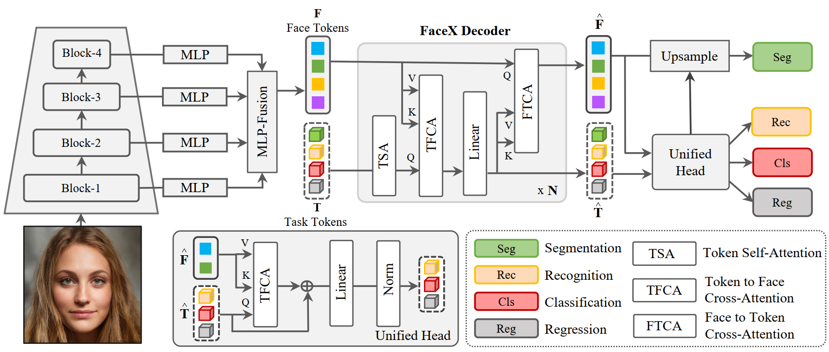
Architecture Overview
FaceXFormer pipeline — encoder → decoder → unified head
Projection
and
Concatenation
Multi-scale encoder
(Swin Transformer)
Backbone: ImageNet-pretrained Swin-B · 33.21 FPS real-time inference · No face-specific pretraining

Slide 5
Implementation Plan — Full Pipeline Reconstruction
What we built · How we trained · What we tested
📦 Datasets (8 tasks · 11 sets)
⚖ Loss Functions (all λᵢ = 1.0)
Train:
CelebAMaskHQ for Face Parsing,
300W for Landmarks Detection,
300W-LP for Head Pose Estimation,
CelebA for Attributes Prediction,
UTKFace and FairFace for Age/Gender/Race estimation,
COFW for Visibility Prediction.
Test:
CelebAMaskHQ for Face Parsing,
300W and 300VW for Landmarks Detection,
BIWI for Head Pose Estimation,
CelebA and LFWA for Attributes Prediction
UTKFace, MORPH-II and FairFace for Age/Gender/Race Estimation,
COFW for Visibility Prediction
· Mean of Dice & CE → Segmentation
· STARLoss → Landmark
· Geodesic → Head pose
· BCE → Attribute & Visibility
· Mean of L1 & CE (decade bins) → Age
· Cross-Entropy → Gender / Race
🖥 Training Infrastructure
· 4 × NVIDIA A100 GPUs or 8 x NVIDIA A6000 GPUs
· PyTorch DDP
🎨 Data Augmentation (per Appendix F)
· Total batch size = 384 · AdamW
Random rotation, random scaling, random translation, random horizontal flip, random gray, random Gaussian blur, random occlusion, random gamma adjustment, random resized crop etc.
· lr = 1e-4 · decay ×0.1 @ ep 6, 10
· 15 epochs + per-epoch checkpoints
⚖ Task-Balanced Sampler
🔬 Ablations
· Upsampling: Equalize the representation of each task’s samples in every batch through upsampling.
Ablations
With vs. without data augmentation
· Batch size 48/GPU across 8 GPUs or 96/GPU across 4 GPUs - every batch draws from all active tasks
Bidirectional vs. standard cross-attention
Balanced vs. unbalanced task sampling

Slide 6
Paper vs. Code: Gap Analysis
4 critical reproducibility findings
#
Component
Paper Claims
Repo Reality
1
Task Scope
10 tasks: parsing, landmark, headpose, attribute, age, gender, race, visibility, expression, face recognition
8 tasks only - facial expression recognition and face recognition completely absent from released checkpoint
2
Task Token Count
11 seg tokens · 68 landmark tokens · 9 headpose tokens (3×3 rotation matrix) · 1 for each other task
Only 11 seg tokens implemented. 1 token for each other task
3
Landmark Head
Hourglass network on 68 task tokens - explicitly stated in Section 3.3
Simple MLP head. No hourglass network anywhere in codebase.
4
Loss Coefficients
Loss = Σ λᵢLᵢ across all tasks. No λᵢ values given anywhere in paper or appendix.
No loss implementation at all. Email to authors confirmed: all λᵢ = 1.0
+ Epoch ambiguity: paper states "3 extra epochs for some tasks" — those tasks never specified anywhere. We trained for 15 epochs for all tasks.

Slide 7
Baseline Verification — Released Checkpoint
Inference only on released weights · Results are FINAL ✓
Task
Dataset
Metric
Paper Target
Our Value
Gap
Status
✓ FINAL RESULTS
Segmentation
CelebAMaskHQ
F1 (%)
92.01%
91.77%
−0.24%
MATCH
Landmark
300W
NME (%)
3.05%
6.75%
+3.7%
CLOSE GAP
Headpose
BIWI
MAE (deg)
3.52°
21.86°
+18.34°
LARGE GAP
Attribute
CelebA
Acc (%)
91.83%
91.74%
−0.09%
MATCH
Age
UTKFace
MAE (yrs)
4.17yr
4.73yr
+0.56yr
MATCH
Gender
FairFace
Acc (%)
95.22%
93.07%
-2.15%
NO TARET
CLOSE GAP
Race
UTKFace
Acc (%)
N/A
97.95%
—
NO TARGET
Visibility
COFW
Recall@P80
72.56%
87.13%
+14.57%
BETTER THAN PAPER
Note: Headpose gap likely a unit/normalization issue.

Slide 8
8-Task Training Results vs. Paper Targets
Our trained model · 12 epochs · 8×A100
⚠ PRELIMINARY — Bug identified in training code for Landmark, Headpose, and Age tasks. These rows are under investigation. Retraining in progress. Other tasks will be mildly affected.
Task
Dataset
Metric
Paper Target
Our Result
Δ Gap
Segmentation
CelebAMaskHQ
F1 (%)
92.01
85.91
−6.1%
CLOSE
Landmark
300W
NME (%)
4.67
0.0117
BUG
BUG ⚠
Headpose
BIWI
MAE (deg)
3.52
0.379
BUG
Attribute
CelebA
Acc (%)
91.83
91.27
−0.56%
Age
UTKFace
MAE (yrs)
4.17
35.27
BUG
Gender
FairFace
Acc (%)
95.22
100
+4.78%
Visibility
COFW
Recall@P80 (%)
72.56
99.25
+26.7%

Slide 9
What This Project Reveals
Reproducibility findings from end-to-end FaceXFormer reconstruction
Weights ≠ Reproducibility
Releasing pretrained weights alone is insufficient. No training loop, no dataloaders, no loss implementations, no multi-task sampler were provided. The unit of reproducibility is the complete training pipeline.
FaceXFormer's architecture holds up. Its paper does not fully support independent reproduction.

